Slide 1


FlyNet: Autonomous Quadcopter Search and Rescue

Slide 2
Motivation
FlyNet: Autonomous Quadcopter Search and Rescue
Req 1: The system shall perform a search for targets in and unknown environment
Req 9: The system shall operate in various indoor lighting conditions
Notes:
Basic flight environment description

Slide 3
System Interface
FlyNet: Autonomous Quadcopter Search and Rescue
Linux companion computer
Path planner
Obstacle avoidance
Notes:
Need to dedicate significant amount of time to systems level tasks i.e leave low level controllers alone if possible

Slide 4
Vehicle Control
FlyNet: Autonomous Quadcopter Search and Rescue
Strategy:
Use as many onboard(autopilot) processes as possible
Use off the shelf hardware/software wherever possible
1st Iteration:
Run position/attitude/altitude controllers on Pixhawk
Use Pixhawk controllers

Slide 5
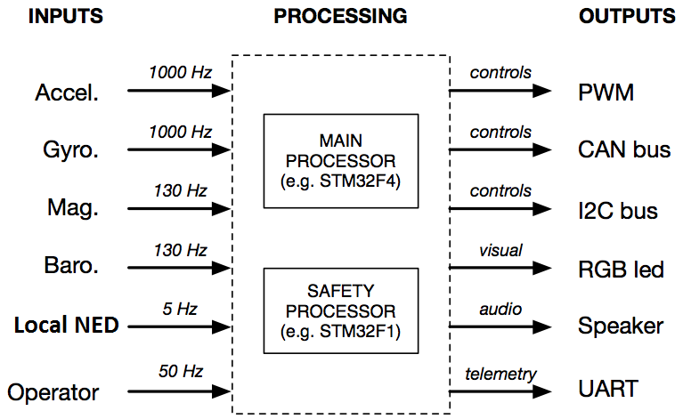
Pixhawk Hardware
FlyNet: Autonomous Quadcopter Search and Rescue
Notes:
Replace gps with local ned

Slide 6
Pixhawk – Off-board Computer Interface
FlyNet: Autonomous Quadcopter Search and Rescue
Embedded Controller (Pixhawk)
Linux Companion Computer
Actuator & Sensor Interface
Safety Controller
SLAM
Obstacle Avoidance
uORB publish/subcribe bus
ROS publish/subscribe bus
UART MAVlink
>250 Hz
< 1 ms latency
Local NED Subscriber
Planner Generated Set point
Local NED Publisher
Path
Planner
Position Controller
Custom
Attitude Controller
Modified
Preexisting

Slide 7
FlyNet: Autonomous Quadcopter Search and Rescue
IMU
p,q,r | a_{x-b} a_{y-b} a_{z-b} |φ_{b}θ_{b}ψ_{b}
Acceleration
Set point
Path Planner
Quadrotor
Actuator Allocator
Attitude Controller
Position Controller
Velocity
Set point
Controller Decision Gate
Position
Set point
Custom
Hardware
Preexisting
Altitude
Set point

